Slide 1


Audio2Art
Team Name: Code_Crusaders
Statement: AI-powered platform transforming voice prompts into visual creations using transformers
College: Vasavi College of Engineering
Location: Ibrahimbagh, Hyderabad

Slide 2

DESCRIPTION
Audio2Art is an advanced project powered by cutting-edge AI technology and transformer models designed to convert audio prompts into stunning visual representations.
This innovative system bridges the gap between auditory and visual experiences, providing users with the ability to generate images from voice descriptions effortlessly.
Audio2Art is versatile and can be utilized across various scenarios, offering creative solutions tailored to different user needs.
3

Slide 3
PROPOSED SOLUTION
Audio2Art allows users to generate unique artworks by simply providing a voice description.
For instance, an artist can describe a scene or concept in detail, and Audio2Art will produce a corresponding image that captures the essence of the spoken words.
This feature enables artists to explore new creative avenues, save time on initial sketches, and focus on refining their artwork. By automating the conversion of audio descriptions to visual art, Audio2Art enhances the creative process and expands artistic possibilities.
5

Slide 4
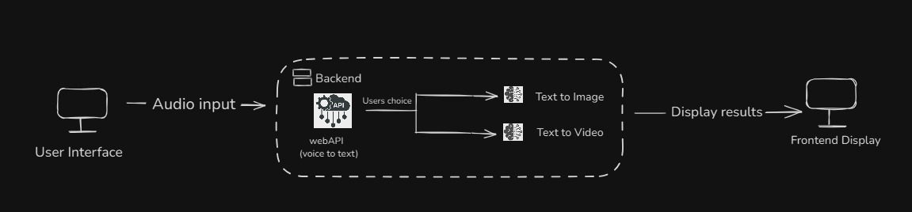
TECH STACK
Frontend:
HTML, CSS, JavaScript
Programming Language:
Python
Models:
Web Speech API, Diffusion for Image Recognition
Backend:
Flask
z

Slide 5
Target Users
Artists & Designers Generate unique visuals inspired by sound for digital and print media.
Musicians & Producers Create stunning artwork for album covers, music videos, and promotional content.
Podcasters & Voice Artists Turn spoken words into artistic visuals for branding and marketing.
Content Creators & Streamers Enhance videos and live streams with AI-generated sound-based visuals.
Event Organizers & DJs Design immersive visuals that sync with live performances.

Slide 6
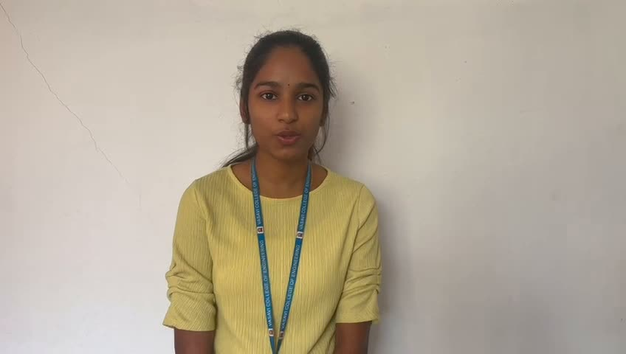
VIDEO EXPLANATION:
6

Slide 7


TEAM DETAILS
Team Leader: Pothula Jahnavi
Branch: IT-B Year: 3rd
Team Member 1: Ravikanti Sharanya
Branch: IT-B Year: 3rd
Team Member 2: Nausheen Haque
Branch: IT-B Year: 3rd
Team Member 3: Tandra Sai Krupa Sanketha
Branch: IT-B Year: 3rd
Team Member 4: Burra Nandhini Reddy
Branch: IT-B Year: 3rd
7

